Slide 1

Modelling Perceptual Decision Making: the Drift Diffusion Model (part B)
Jaime de la Rocha
Brain Circuits and Behavior Lab, IDIBAPS
Slides are based on previous lectures by Alfonso Renart and Anne Urai

Slide 2
Outline
Signal Detection Theory
Sequential Probability Ratio Test (SPRT)
Drift Diffusion Model (DDM)
Applications and extensions of the DDM.

Slide 3
Sequential Sampling Analysis
Decisions are not instantaneous but unfold in time
Why do we care?
Changes the task fundamentally as there are 2 things to decided: When to decide and What to do.
The timing of decisions is a very valuable ‘diagnostic’ observable: when they are made can inform about how they are made.
Some tasks show no variability in response accuracy (i.e. no errors)
Sequential sampling theories describe situations where stimuli arrive ‘in time’ (i.e., sensory streams) and agents decide both When and What.

Slide 4
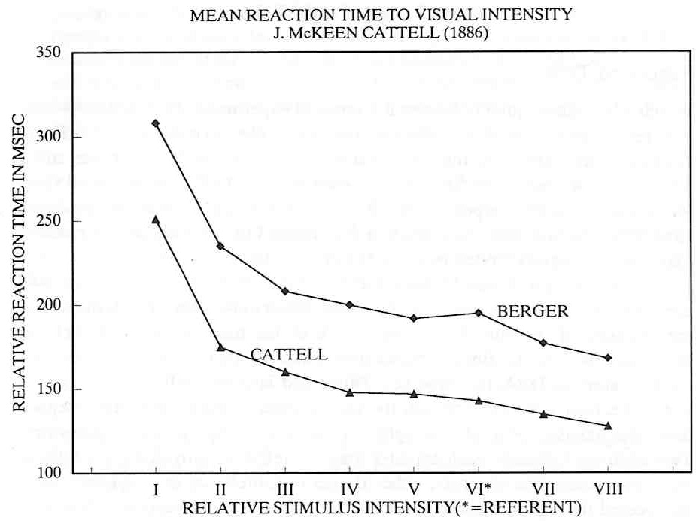
RT is inversely related to Accuracy
Cattell, 1886
The trade-off between speed and accuracy is the fundamental lawful relationship in sequential sampling.

Slide 5
Inference “Urns game”
- Each urn has a different fraction of red and green balls (e.g.
- One urn is chosen randomly and balls are extracted sequentially from it.
Urn H0
Urn H1
80:20
20:80
- How many balls should I extract to infer the urn chosen is H0 or H1?
Mask
x₄
x₃
x₂
x₁

Slide 6
N =N_{red} - N_{green}10
N=2
N=1
- How many balls should I extract to infer the urn chosen is H0 or H1?
- Answer: Depends on:
- how accurate I want to be in my decision.
- what is the mean evidence provided by each ball

Slide 7


Sequential Probability Ratio Test (SPRT)
Wald, 1947; Wald & Wolfowitz, 1948
Bayes Theorem:
$$p(A|B)=\frac{P(A)P(B|A)}{P(B)}$$
Urn 0
Ball observation
$$p(H_{0}|x)=\frac{P(H_{0})P(x|H_{0})}{P(x)}$$

Slide 8
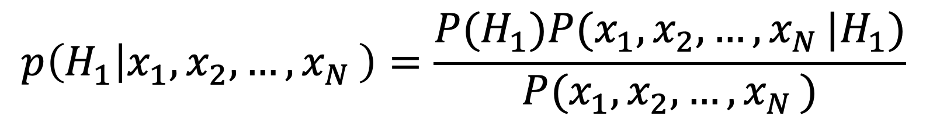
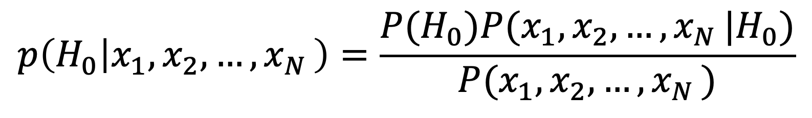
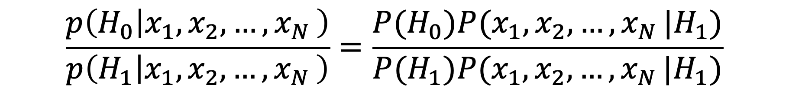
Prior
likelihood
Posterior probability
$$p\left(H_{0} | x_{1},x_{2}, …{,x}_{N}\right)=\frac{P(H_{0})P(x_{1},x_{2}, …{,x}_{N}|H_{0})}{P(x_{1},x_{2}, …{,x}_{N})}$$
$$p\left(H_{1} | x_{1},x_{2}, …{,x}_{N}\right)=\frac{P(H_{1})P(x_{1},x_{2}, …{,x}_{N}|H_{1})}{P(x_{1},x_{2}, …{,x}_{N})}$$
Probability Ratio:
$$\frac{p\left(H_{0} | x_{1},x_{2}, …{,x}_{N}\right)}{p\left(H_{1} | x_{1},x_{2}, …{,x}_{N}\right)}=\frac{P(H_{0})P(x_{1},x_{2}, …{,x}_{N}|H_{1})}{P(H_{1})P(x_{1},x_{2}, …{,x}_{N}|H_{1})}$$

Slide 9
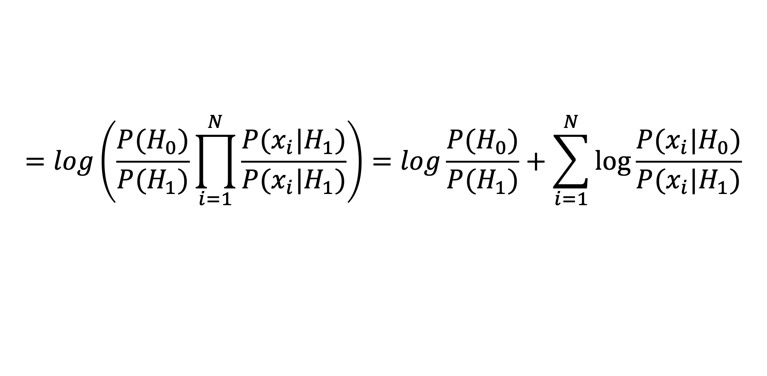
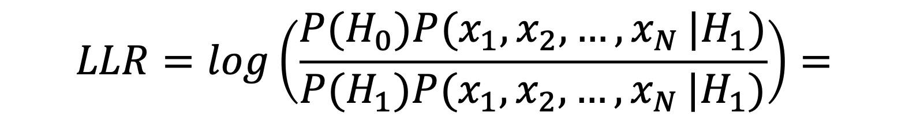
Log Probability Ratio:
Samples x_{i} are independent
$$LLR=log\left(\frac{P(H_{0})P(x_{1},x_{2}, …{,x}_{N}|H_{1})}{P(H_{1})P(x_{1},x_{2}, …{,x}_{N}|H_{1})}\right)=$$
Log likelihood ratio = evidence e_{i}
Prior
$$=log\left(\frac{P(H_{0})}{P(H_{1})}\prod_{i=1}^{N}{\frac{P(x_{i}|H_{1})}{P(x_{i}|H_{1})}}\right)=log\frac{P(H_{0})}{P(H_{1})}+\sum_{i=1}^{N}{\log{\frac{P(x_{i}|H_{0})}{P(x_{i}|H_{1})}}}$$

Slide 10
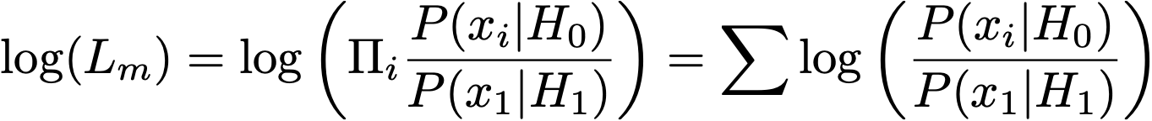
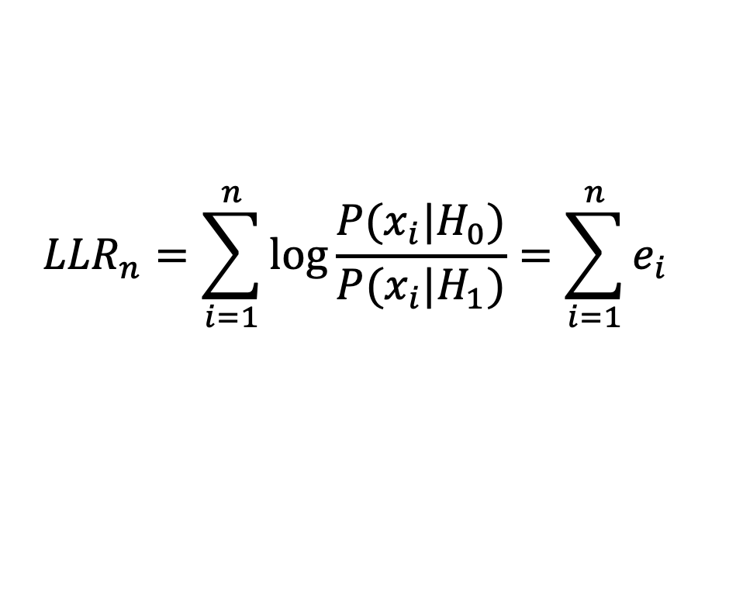
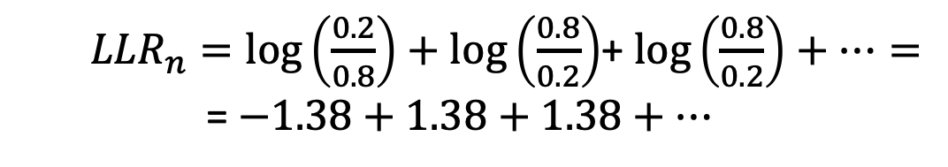

Inference “Urns game”
Assume: ${P(H}_{0}) ={P(H}_{1})$
$${LLR}_{n}=\sum_{i=1}^{n}{\log{\frac{P(x_{i}|H_{0})}{P(x_{i}|H_{1})}=\sum_{i=1}^{n}{e_{i}}}}$$
Urn H0
Urn H1
80:20
20:80
P(red-ball | H0) = 0.8
P(green-ball | H0) = 0.2
P(red-ball | H1) = 0.2
P(green-ball | H1) = 0.8
e₁
e₂
e₃
${LLR}_{n}=log\left(\frac{0.2}{0.8}\right)+log\left(\frac{0.8}{0.2}\right)$+ $log\left(\frac{0.8}{0.2}\right)+…=$
= $−1.38+1.38+1.38+…$
Mask
e₄
e₃
e₂
e₁

Slide 11
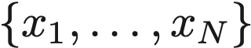
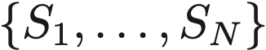
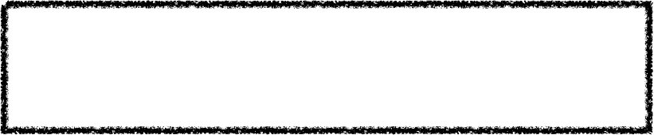
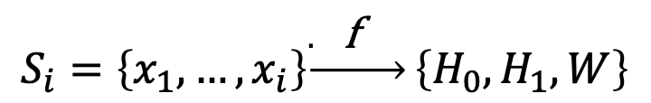
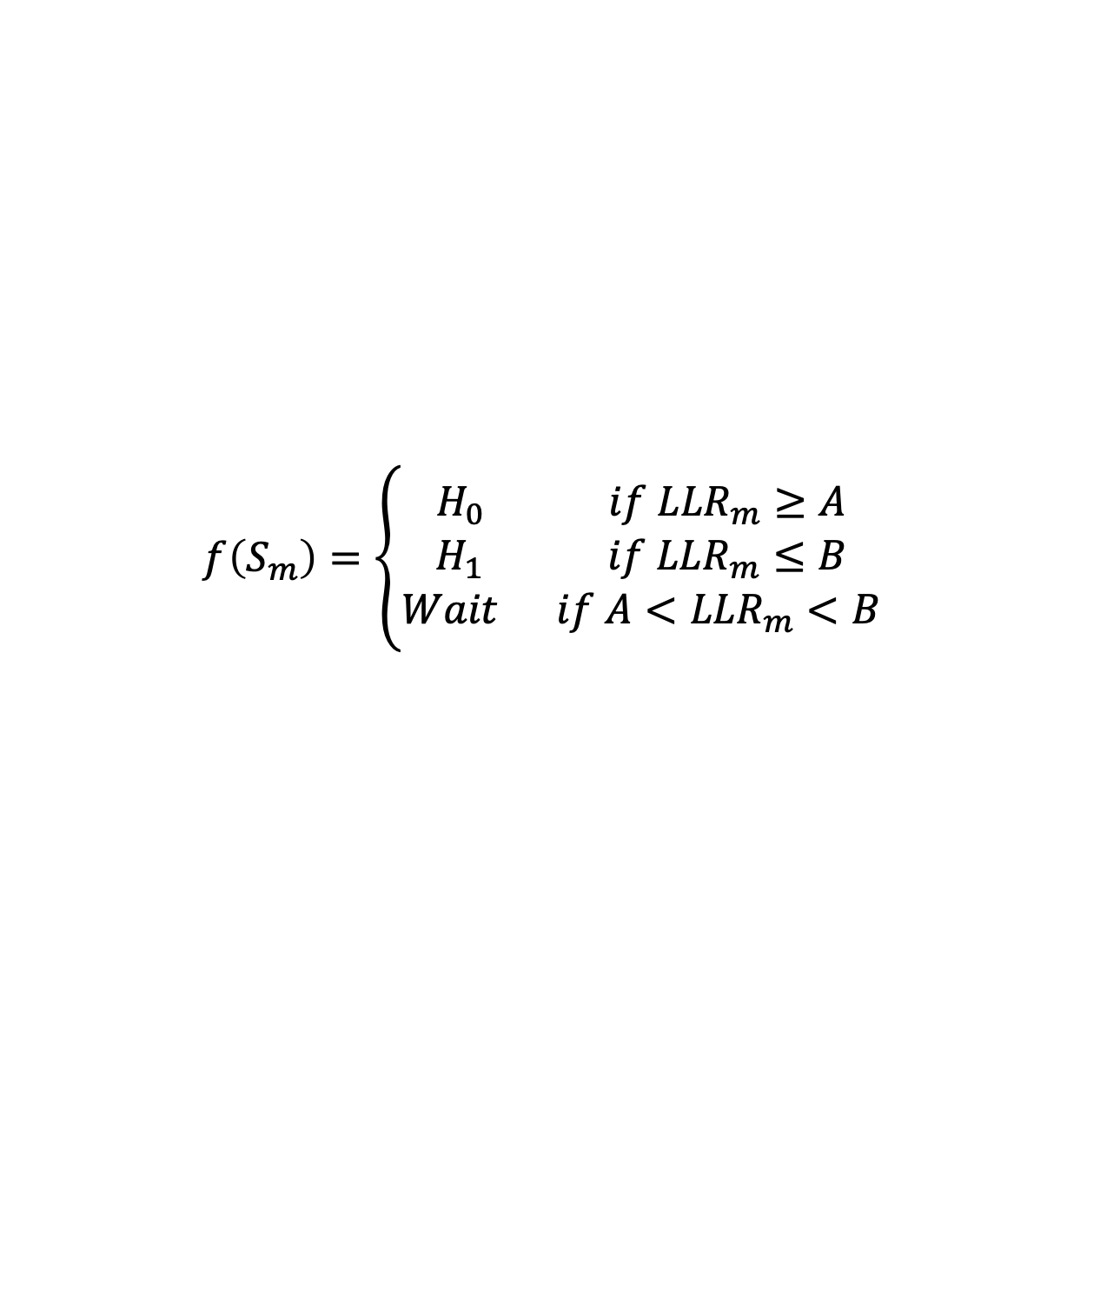
Sequential Probability Ratio Test (SPRT)
Wald, 1947; Wald & Wolfowitz, 1948
We have two hypotheses H₀ and H₁
Consider N sequential observations
A sequential decision strategy is a set of decision functions
$$S_{i}=\left\{x_{1}, …, x_{i}\right\}\underset{→}{. \text{f} }\left\{H_{0},H_{1},W\right\}$$
Decision Rule (SPRT)
$$f\left(S_{m}\right)=\left\{\begin{aligned}H_{0} if {LLR}_{m}≥A \\ H_{1} if {LLR}_{m}≤B \\ Wait if {A<LLR}_{m}<B\end{aligned}\right.$$
The decision bounds A and B determine the probability of making an error
The SPRT is optimal in the sense of having the least
Expected “decision time” for a given error rate

Slide 12
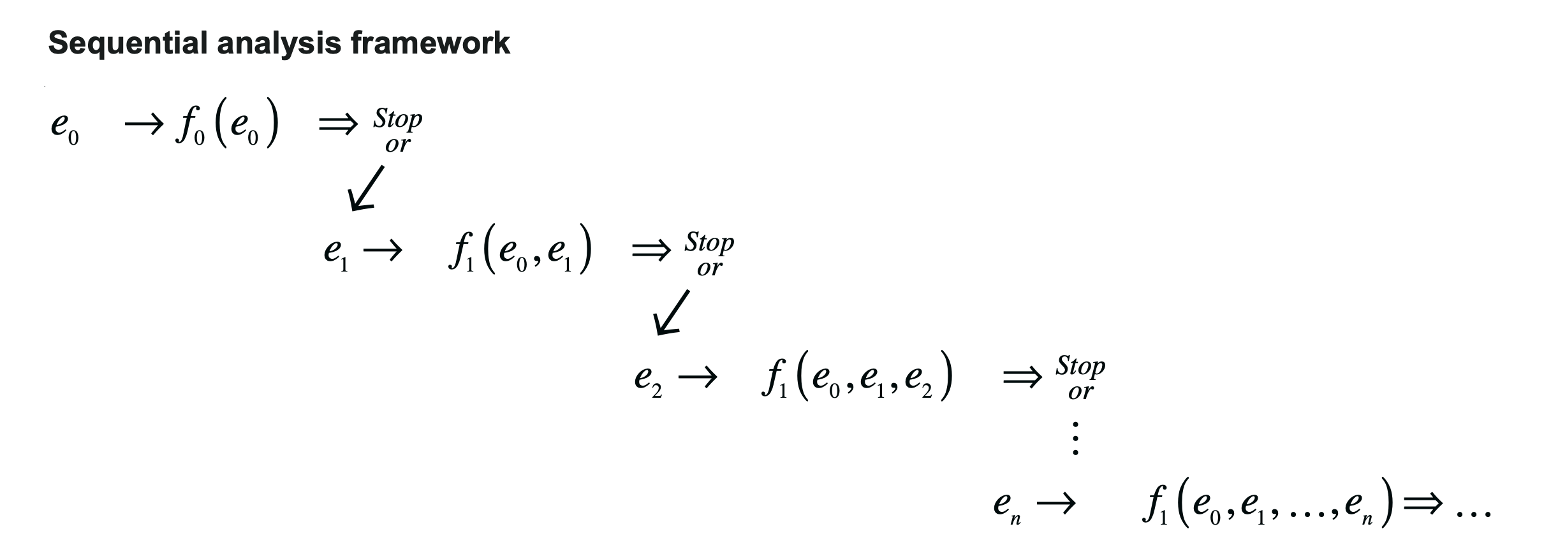
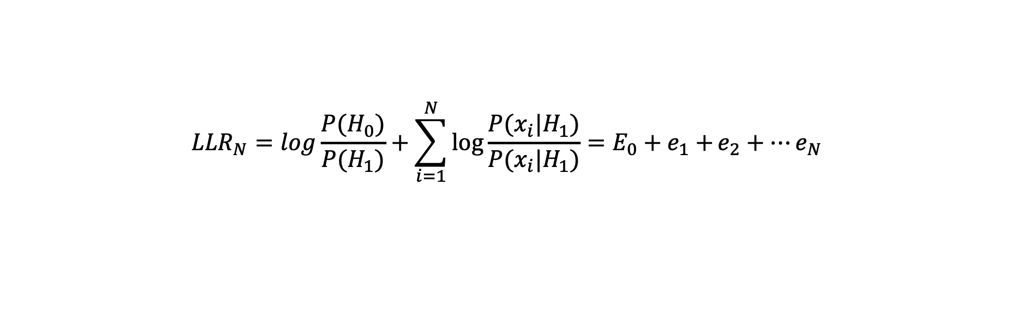
Sequential Probability Ratio Test (SPRT)
$${LLR}_{N}=log\frac{P(H_{0})}{P(H_{1})}+\sum_{i=1}^{N}{\log{\frac{P(x_{i}|H_{1})}{P(x_{i}|H_{1})}=E_{0}+e_{1}+}e_{2}+…e_{N}}$$
At every time-step, accumulate LLRi until A,B
Update running count of the Log Likelihood Ratio
Receive an observation (data sample)
Wald, 1947; Wald & Wolfowitz, 1948

Slide 13
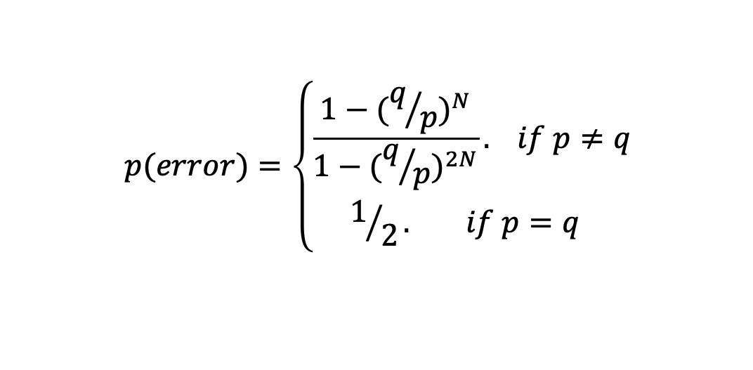
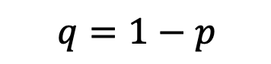
- There is a direct relationship between the error rate and the bound magnitude which is hard to compute analytically for the general case.
- Can be obtained for the Urns game:
$$p(error)=\left\{\begin{aligned}\frac{1−{(q/p)}^{N}}{1−{(q/p)}^{2N}}. if p≠q \\ 1/2. if p=q \end{aligned}\right.$$
p is the prob(red ball)
$$q=1−p$$
N is the bound size

Slide 14
The relationship between error probability and the bound N in units of accumulated count difference, depends on the statistics of the urns (i.e. the prob. p).
Transforming to evidence the relationship between error probability and the bound is univocal.
The limitation of finding the bound in practice, is that we must know the statistics of the system (i.e. p) to compute the likelihoods and compute the bound.
This is a limitation in many experiments in which the difficulty of the trials (e.g. coherence or p in this game) is changed from trial to trial.

Slide 15
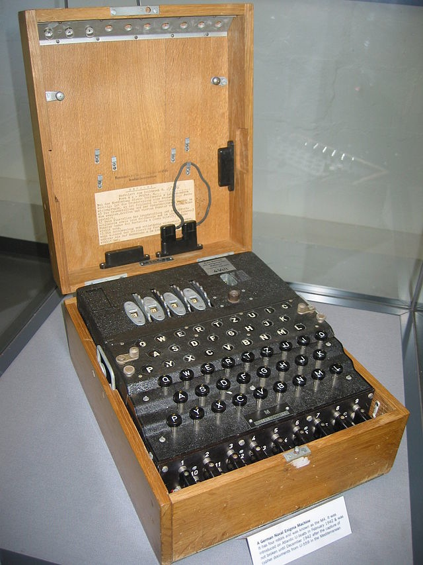

A brief historical detour
Notes:
I will talk to you today about how your brain deals with this noise in your everyday life, and manages to make good decisions even when it’s foggy outside.
To understand how the brain deals with noise, let’s take a history tour, from the African plains to the England of 1940.
The Germans used this device, the Enigma, to send each other messages during the war. They decoded their messages so that whatever they sent over the would be incomprehensible. Enigma on the other side of the line would have the same settings and could change the message back to its original. The Allies sometimes intercepted German messages, but could not read them.
This gentleman Alan Turing, often called the father of modern computing, was in charge with the development of cryptography that could break the Enigma’s code and read German messages.
Each day, a team of English code-breakers would try different possible ways to decode the messages they intercepted. The problem that they faced was knowing when to stop trying a possible code, and switch to another one. It would be too time-consuming to try out each possible code on all text they had from the Germans. But it would also be a mistake to not try a code on enough text, and risk missing important information. The key idea that Turing came up with, and that will be essential to understanding how the brain makes decision, is ‘evidence integration’.

Slide 16
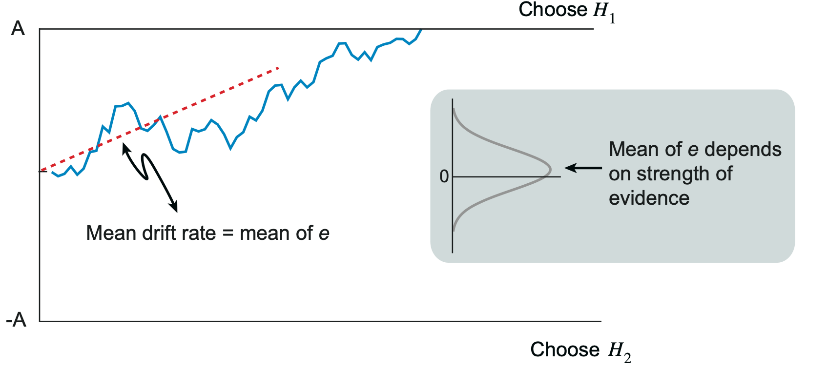
Sequential Probability Ratio Test (SPRT)
Wald, 1947; Wald & Wolfowitz, 1948
Choose H0
Accumulated evidence for H0 over H1
Mean drift rate = mean of LRi
(which reflects strength of evidence
Choose H1
The rate of accumulation depends on the strength of the evidence
The thresholds depend on the error rate we want to achieve. Upon hiting the bound, by definition, the probability
of a correct choice is the same regardless of the evidence strength.
For given evidence strength, better decisions require more time
Speed-Accuracy Trade-Off (SAT) !!
For a given accuracy, lower evidence strength also takes more time

Slide 17
Outline
Signal Detection Theory
Sequential Probability Ratio Test (SPRT)
Drift Diffusion Model (DDM)
Applications and extensions of the DDM.

Slide 18
Sequential sampling models (SSM)
SSMs posit that the brain makes decisions by sampling noisy evidence over time, up to a threshold.
Multiple model variants:
relative vs absolute evidence accumulation
Discrete vs continuous time
Leak vs perfect accumulation

Slide 19
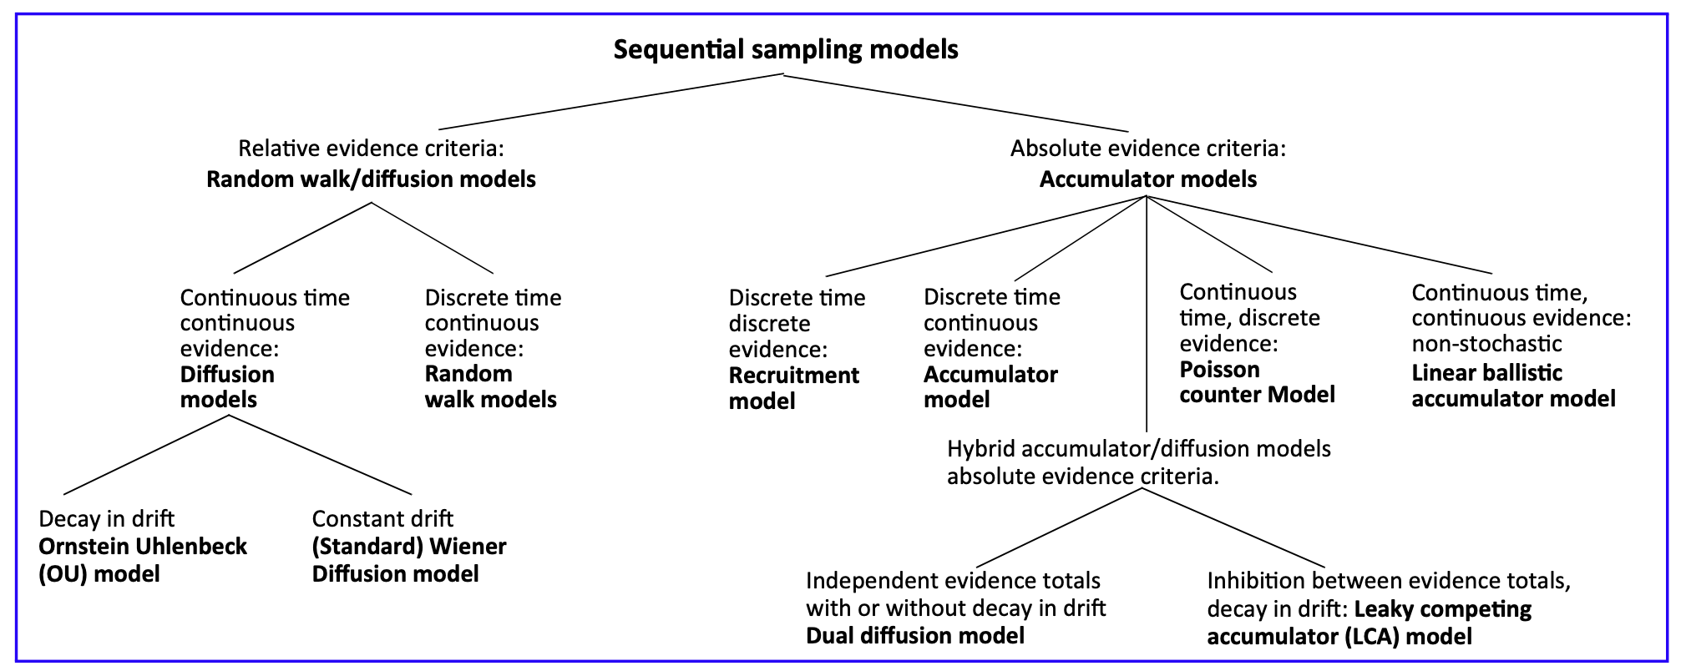
Ratcliff et al., TICS, 2016
aka ‘Drift Diffusion Model.
First introduced by Ratcliff

Slide 20
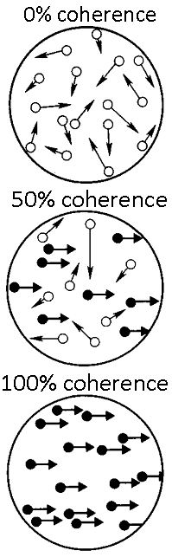
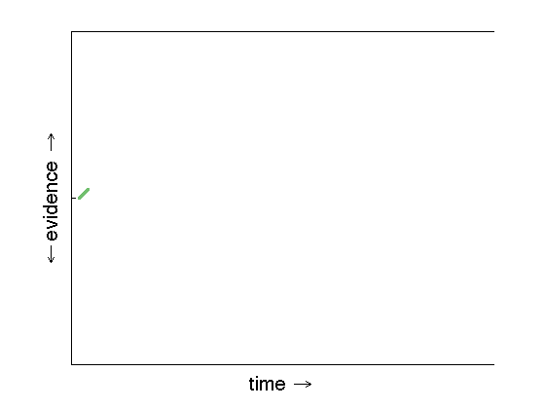
Dots move to the right
Dots move to the left
Notes:
Let’s put this idea in a picture. Time, or the number of possible codes tried out, elapses from left to right. This line at the top indicates that the code is a good one, for example decoding the message ‘retreat immediately’ that the Germans might be sending each other. The line at the bottom indicates that the code is worthless, and gives you only random messages.
Each time the code breakers would try a code on a new piece of text, they would assign a value to the outcome; positive if it resembled German words, negative if it was nonsense. If there was a perfect German word the evidence would be higher than if the code gave an almost-German word with still some mistakes in it.
Turing had the insight to integrate, or add together over time, this evidence. For each next word that the code breakers tried, the evidence was added up with what was already there. When the code was a good one, the evidence would steadily go up as more messages are decoded. For a bad code, the integrated evidence steadily went down. What Turing decided is that it would be good to have a fixed boundary, indicated by the lower and upper lines, on the amount of evidence they would gather. Until the evidence hits one of the two lines, you keep trying; when it does, you know whether this code is useful or not. Mathematically, we can show this this process of adding up the evidence results in the best possible decisions when you are faced with noise. In fact, the idea of integration is that you average out the noise, and are left with the signal you’re interested in.

Slide 21
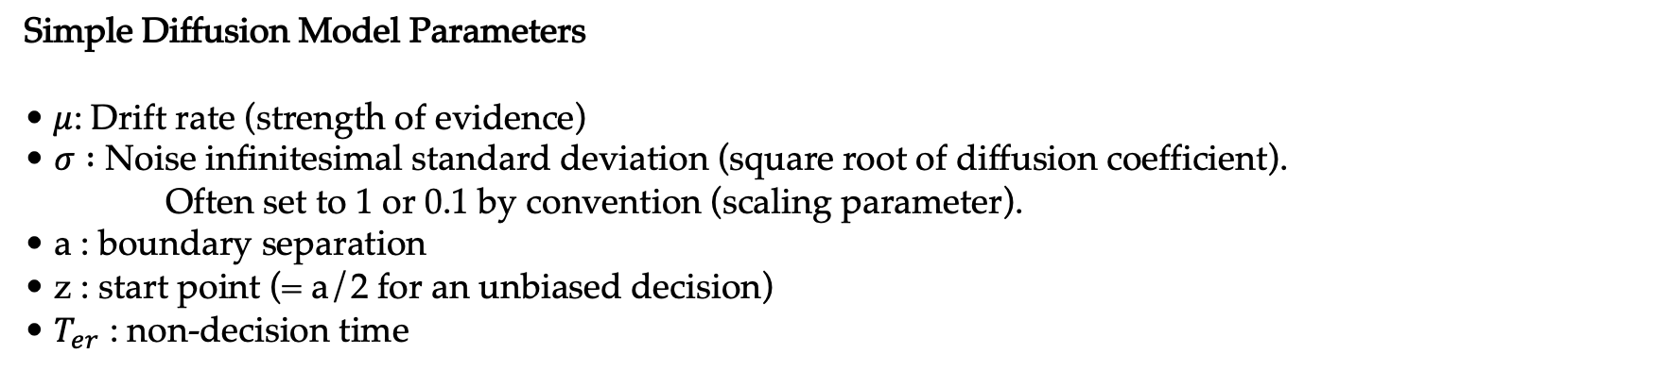
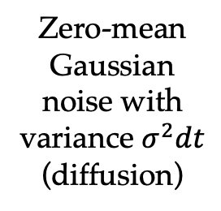
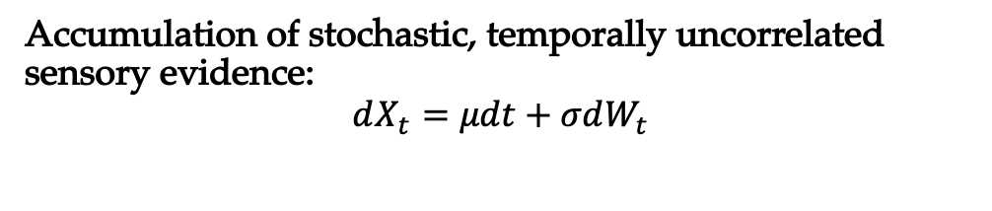
The Drift Diffusion Model
Correct
Accumulation of stochastic, temporally uncorrelated sensory evidence:
$$dX_{t}=μdt+σdW_{t}$$
+a
‘decision variable’
Zero-mean Gaussian noise with variance $σ^{2}dt$
(diffusion)
-a
Evidence accumulation
Error
Simple Diffusion Model Parameters
•$μ$: Drift rate (strength of evidence)
• $σ :$ Noise infinitesimal standard deviation (square root of diffusion coefficient). Often set to 1 or 0.1 by convention (scaling parameter).
• a : boundary separation
• z : start point (= a/2 for an unbiased decision)
• $T_{er}$ : non-decision time
$$RT=t_{D}+t_{ND}$$
‘non-decision time’ sensory encoding and motor delays

Slide 22
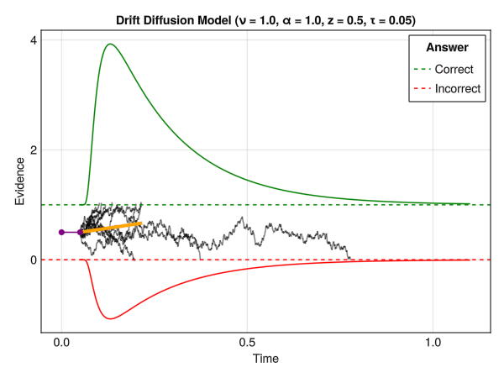
The Drift Diffusion Model
Each parameter uniquely affects RT distributions and accuracies.
For each set of parameters (i.e. for each experimental condition), we obtain a choice probability P(Correct) and two predicted RT distributions: correct and error responses (or left vs right responses).
Selective influence: an experimental manipulation that influences just a single parameter—all other parameters can be shared across the conditions.
https://dominiquemakowski.github.io/CognitiveModels/4b_rt_generative.html

Slide 23
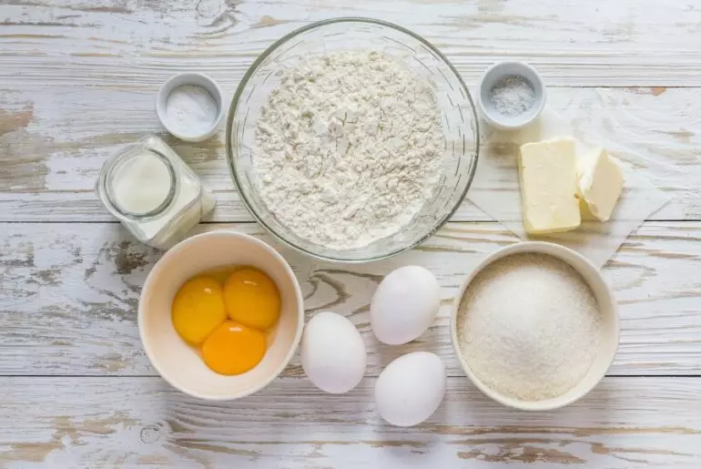
The DDM’s ingredients

Slide 24
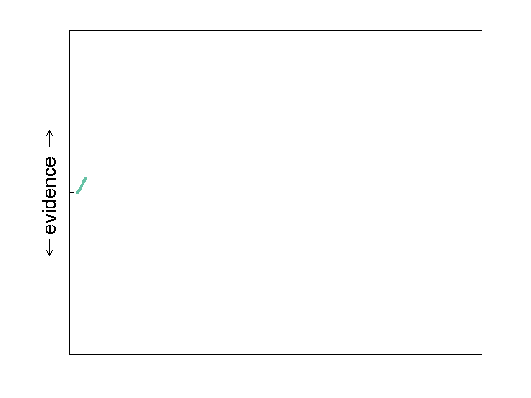
DDM ingredients: evidence strength
time
Notes:
Such build-up of information is also what your brain does when faced with a foggy forest: rather than making a blink-of-an-eye decision, it adds up information over some time. In this graph, the upper bound means you just saw a cat and can relax, whereas the lower boundary indicates you’d better run very fast. On a sunny day, there is not much noise and the cat evidence builds up fast. However, if you can’t see the cat very well, as in this light-green trace, you might take longer to integrate enough evidence. If there’s a tiger, on the other hand, the evidence will go towards the other boundary in this red trace.
Evolutionarily, this method gives you the advantage of making an informed choice based on all the information out there in the world, rather than running for your life each time you hear something behind you.The beauty of this methods is that it’s optimal in a very precise sense: if there is limited information available in noise, then by accumulating evidence you average out the noise and make the best possible decision.

Slide 25
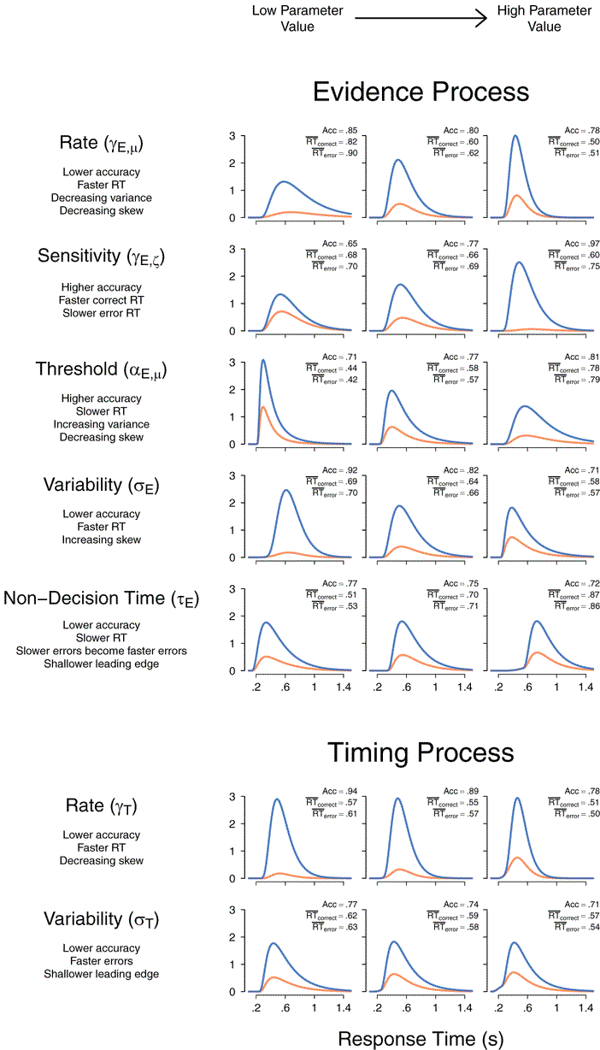
Changing evidence strength
Increasing the drift rate:
Higher accuracy
Faster RT for both correct and error choices.
− drift rate +
Palmer et al. 2005

Slide 26
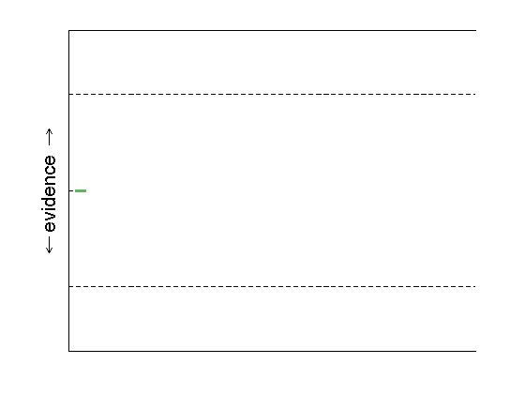
DDM ingredients: boundary adjustment
time
Notes:
Let’s go to the last example. One important missing piece of the puzzle so far, is that it would always take the same amount of time to integrate our evidence. But what if you’re in a hurry, and need quick decision making? The easiest solution here is to change your decision bound. So far, we have always seen this same solid line where the evidence integration stops. However, when you need quick decision making, you can use this dotted line here instead: because less evidence is needed, your decision will be reached faster. Research has shown that in all kinds of situations, people can be flexible in how much evidence they accumulate if their goal changes from making less mistakes to being faster.
A very real-life example of this is behaviour in traffic. If you’re driving or cycling and it’s raining, you should increase your decision bound and integrate more information before you decide whether to go left or right. In other words, when there is a lot of noise in the world, it might be better to be more cautious. If you are late for an appointment, however, you might not take your time and decide sooner, with the risk of making a mistake.

Slide 27
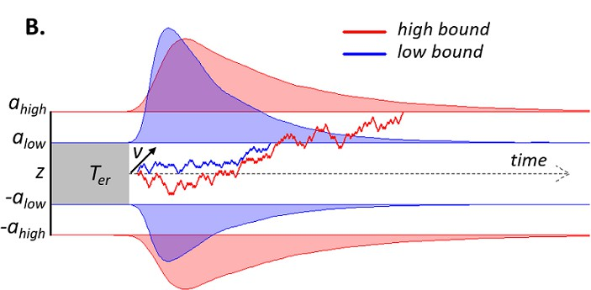
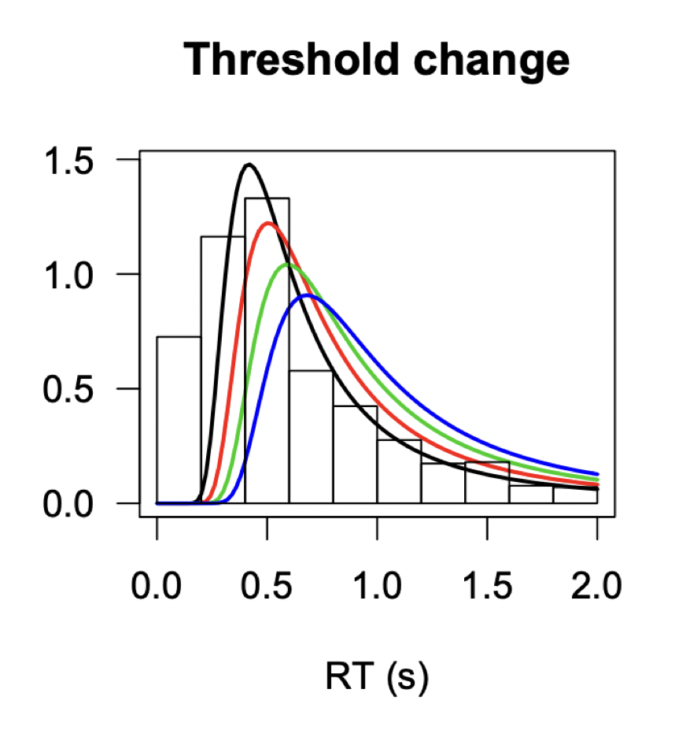
Speed-accuracy trade-off
Increasing the bound:
Higher accuracy
Slower RT
Increasing RT variance
Decreasing skew
Desender et al 2019
Correct
Error
Palmer et al. 2005
− decision bound +

Slide 28
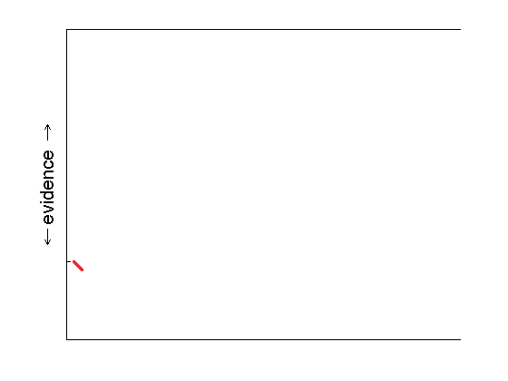
DDM ingredients: starting point
time
Notes:
Another good example of what we can do with this model, is changing the starting point for one of the options. Some of you might have wondered if it’s not weird that you need the same amount of evidence to decide for a tiger and a cat; clearly, in this example it’s better to be cautious and be quicker if there is only a small chance you might face a tiger. In the model, this is quite simply done by changing the point at which we start the evidence integration: as you can see in this picture, we start the integration closer to the tiger bound, so that we’re quicker to recognise the tiger than the cat. In other words, the tiger needs less evidence before it is chosen, since we would rather run a few times when there’s a cat than relax once when there’s a tiger.

Slide 29
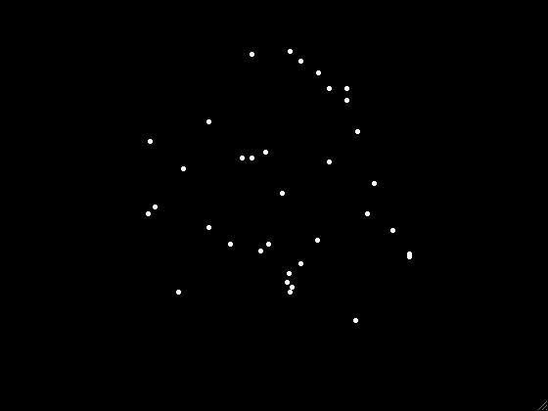
Motion discrimination task
Coherence = 0.1

Slide 30
Motion discrimination task
- This arrow (stimulus precue) predicts the motion direction only in 75% of the trials.
- It creates an unbalanced prior expectation in the subject that can be leverared to increase response accuracy.

Slide 31
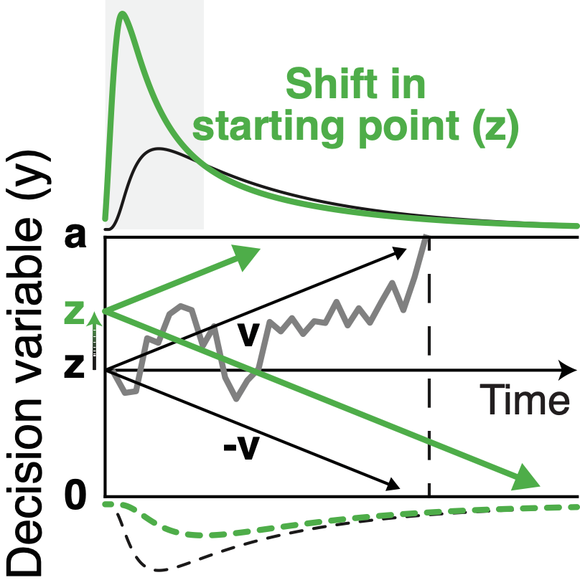
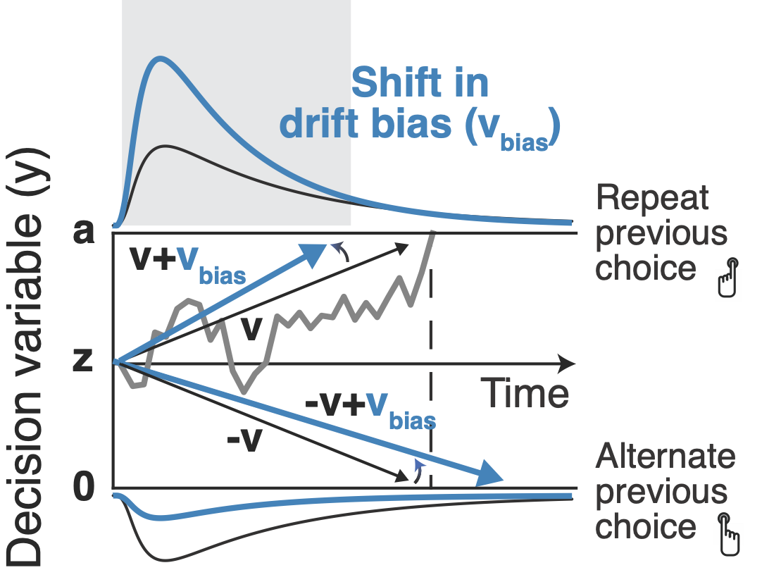
Decision biases
Urai, de Gee, Tsetsos & Donner, eLife (2019)
Notes:
Don’t apologize for equations!

Slide 32

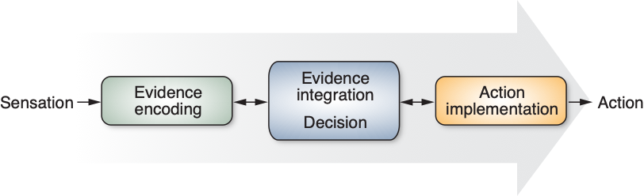

Response times: arising from processing stages
(Donders 1869, Sternberg 1969)

Slide 33
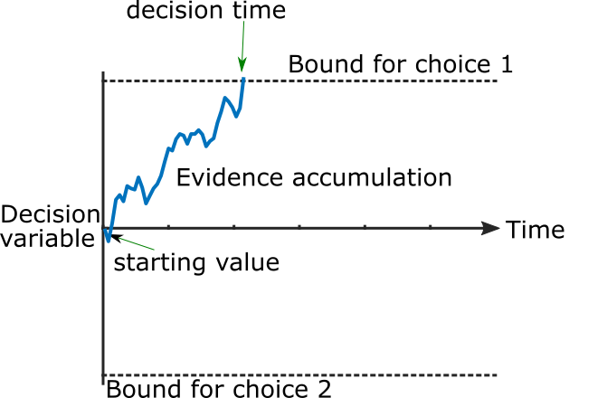
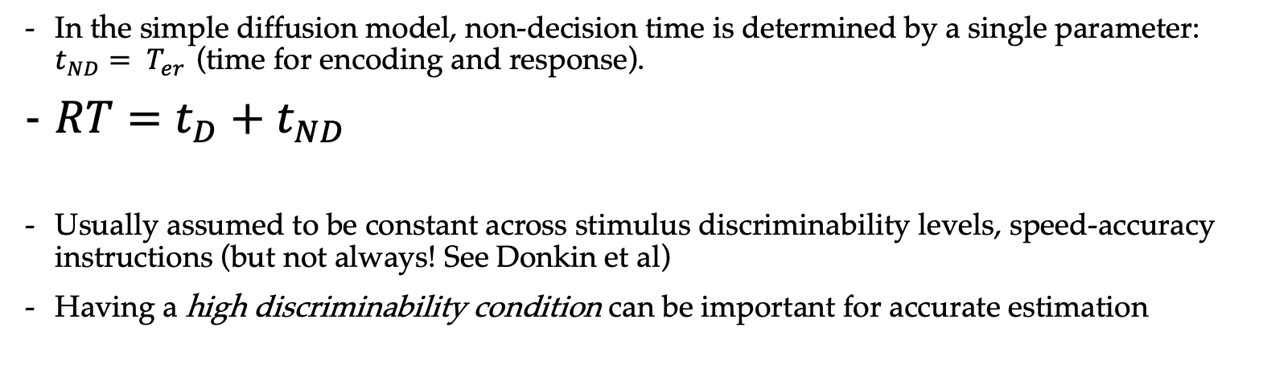
DDM ingredients: non-decision time
In the simple diffusion model, non-decision time is determined by a single parameter: ${t_{ND}= T}_{er}$ (time for encoding and response).
$RT=t_{D}+t_{ND}$
Usually assumed to be constant across stimulus discriminability levels, speed-accuracy instructions (but not always! See Donkin et al)
Having a high discriminability condition can be important for accurate estimation
Encode
Sensory Information
Plan & Execute
Action
Not the most realistic, evidence for continuous flow to the motor system

Slide 34
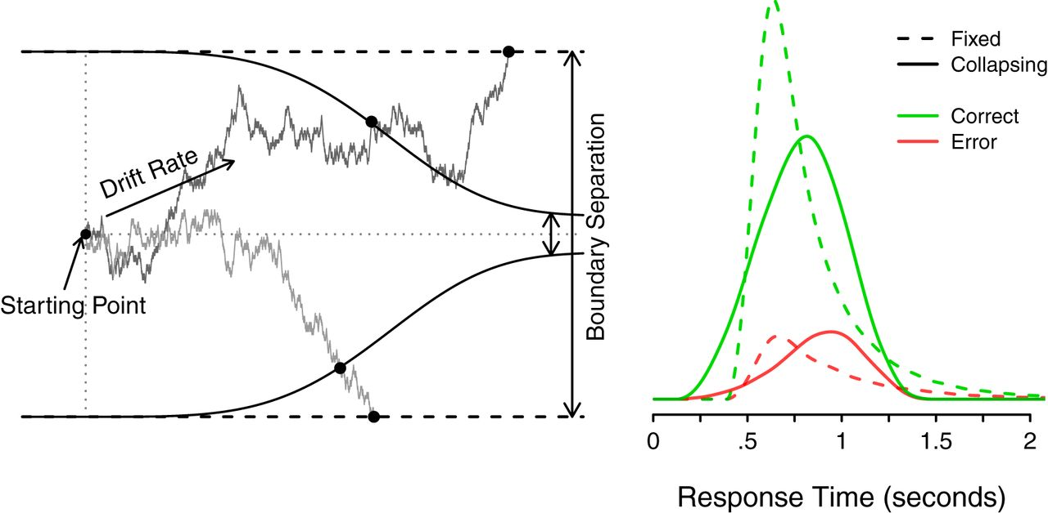
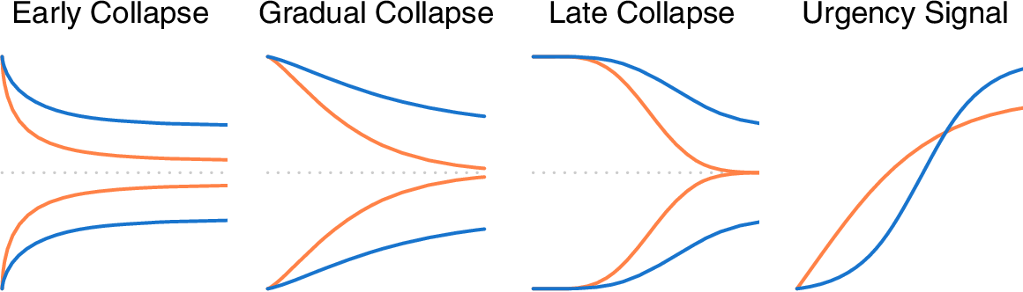
Collapsing bounds / urgency
Another mechanism to produce slow errors
Controversial in the literature.. requires additional parameters to be estimated
But, collapsing bounds are inconsistent with the neuroscience (build to threshold signals)
In the context of racing accumulators, additive urgency is mathematically equivalent to a collapsing bound (Ditterich 2006)
Several studies have found neurophysiological evidence for urgency (Churchland et al, 2008, Thura & Cisek 2014, Corbett et al, 2023)
Hawkins et al., 2015

